Slide 1

What is a Sorting Algorithm?
Sorting algorithm
An algorithm that rearranges elements in a collection
In non-decreasing order
Elements must be comparable
Unsorted list
sorting
Sorted list
10 | 3 | 7 | 3 | 4
3 | 3 | 4 | 7 | 10

Slide 2
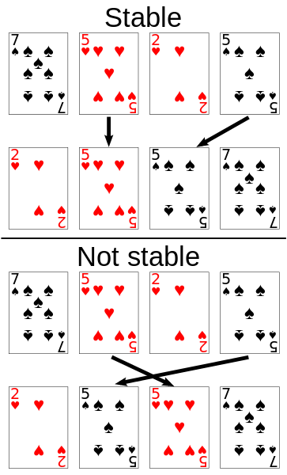
Stability of Sorting
Stable sorting algorithms
Maintain the order of equal elements
If two items compare as equal, their relative order is preserved
Unstable sorting algorithms
Rearrange the equal elements in unpredictable order

Slide 3
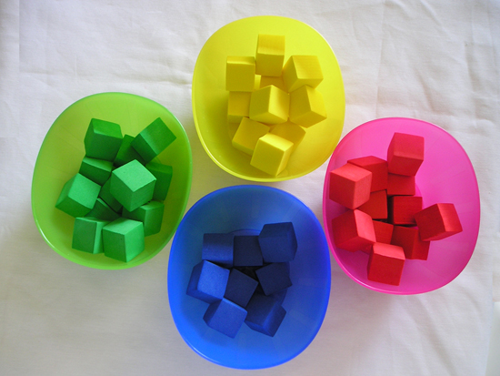

Selection Sort
Swap each element with the min element on its right
Visualize
repeat (numOfElements - 1) times
set the first element as min
for each of the next elements
if element < currentMinimum
set element as new minimum
swap minimum with first element

Slide 4
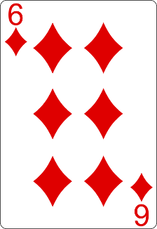
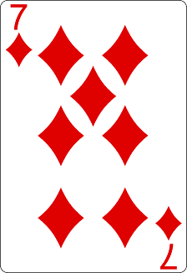
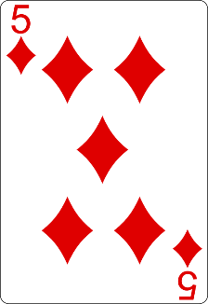
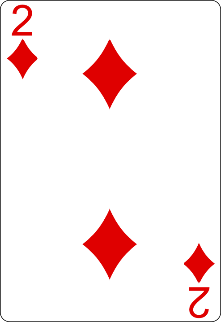
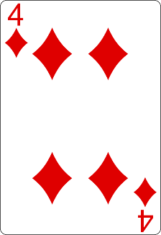
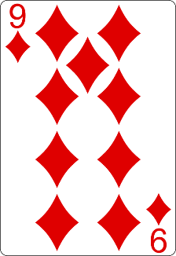
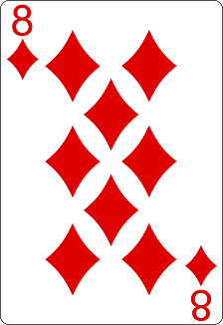
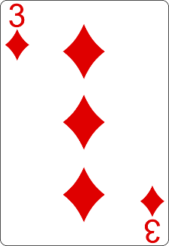
Selection Sort Visualization
Steps count: 8 + 1 ⇨ 9
Finding the smallest element takes 8 steps
Index
Min
Swapping elements counts as an extra step

Slide 5
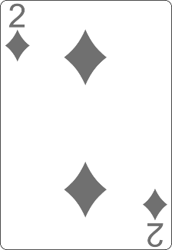
Selection Sort Visualization
Steps count: 9 + 7 + 1 ⇨ 17
Finding the smallest element takes 7 steps
Index
Min

Slide 6
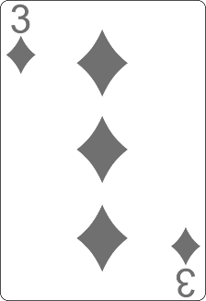
Selection Sort Visualization
Steps count: 17 + 6 + 1 ⇨ 24
Finding the smallest element takes 6 steps
Index
Min

Slide 7
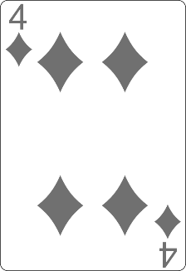
Selection Sort Visualization
Steps count: 24 + 5 + 1 ⇨ 30
Finding the smallest element takes 5 steps
Index
Min

Slide 8
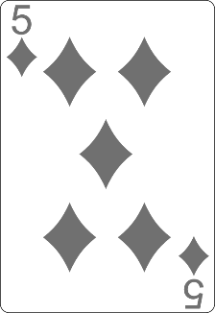
Selection Sort Visualization
Steps count: 30 + 4 ⇨ 34
Finding the smallest element takes 4 steps
Min
Index

Slide 9
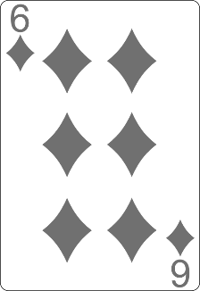
Selection Sort Visualization
Steps count: 34 + 3 + 1 ⇨ 38
Finding the smallest element takes 3 steps
Index
Min

Slide 10
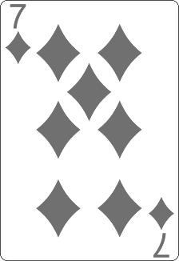
Selection Sort Visualization
Steps count: 38 + 2 ⇨ 40
Finding the smallest element takes 2 steps
Min
Index

Slide 11
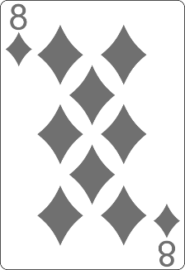
Selection Sort Visualization
Steps count: 40 + 1 ⇨ 41
Min
Index
Finding the smallest element takes 1 step

Slide 12
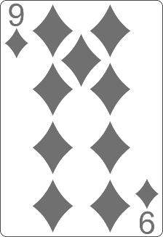
Selection Sort Visualization
Total count of steps : 41

Slide 13
Selection Sort Code
for (int index = 0; index < collection.length; index++){
int min = index;
for (int curr = index + 1; curr < collection.length; curr++){
if (collection[curr] < collection[min]){
min = curr;
}
}
swap(collection, index, min);
}
Find the smallest element
Swap current with it

Slide 14
Bubble Sort
Swaps neighbor elements when not in order until sorted
Visualize
do
swapped = false
for i = 1 to collection length
if leftElement > rightElement
swap(leftElement, rightElement)
swapped = true
while swapped

Slide 15
Bubble Sort Visualization
Steps count: 1
i
j

Slide 16
Bubble Sort Visualization
Steps count: 1 + 1 + 1 ⇨ 3
i
j
Swapping elements counts as an extra step

Slide 17
Bubble Sort Visualization
Steps count: 3 + 1 + 1 ⇨ 5
i
j

Slide 18
Bubble Sort Visualization
Steps count: 5 + 1 + 1 ⇨ 7
i
j

Slide 19
Bubble Sort Visualization
Steps count: 7 + 1 ⇨ 8
i
j

Slide 20
Bubble Sort Visualization
Steps count: 8 + 1 + 1 ⇨ 10
i
j

Slide 21
Bubble Sort Visualization
Steps count: 10 + 1 + 1 ⇨ 12
i
j

Slide 22
Bubble Sort Visualization
Steps count: 12 + 1 + 1 ⇨ 14
i
j

Slide 23
Bubble Sort Visualization
Steps count: 14 + 1 + 1 ⇨ 16
i
j

Slide 24
Bubble Sort Visualization
Steps count: 16 + 1 + 1 ⇨ 18
i
j

Slide 25
Bubble Sort Visualization
Steps count: 18 + 1 ⇨ 19
i
j

Slide 26
Bubble Sort Visualization
Steps count: 19 + 1 ⇨ 20
i
j

Slide 27
Bubble Sort Visualization
Steps count: 20 + 1 + 1 ⇨ 22
i
j

Slide 28
Bubble Sort Visualization
Steps count: 22 + 1 + 1 ⇨ 24
i
j

Slide 29
Bubble Sort Visualization
Steps count: 24 + 1 + 1 ⇨ 26
i
j

Slide 30
Bubble Sort Visualization
Steps count: 26 + 1 ⇨ 27
i
j

Slide 31
Bubble Sort Visualization
Steps count: 27 + 1 ⇨ 28
i
j

Slide 32
Bubble Sort Visualization
Steps count: 28 + 1 + 1 ⇨ 30
i
j

Slide 33
Bubble Sort Visualization
Steps count: 30 + 1 ⇨ 31
i
j

Slide 34
Bubble Sort Visualization
Steps count: 31 + 1 ⇨ 32
i
j

Slide 35
Bubble Sort Visualization
Steps count: 32 + 1 ⇨ 33
i
j

Slide 36
Bubble Sort Visualization
Steps count: 33 + 1 + 1 ⇨ 35
i
j

Slide 37
Bubble Sort Visualization
Steps count: 35 + 1 ⇨ 36
i
j

Slide 38
Bubble Sort Visualization
Steps count: 36 + 1 ⇨ 37
i
j

Slide 39
Bubble Sort Visualization
Steps count: 37 + 1 + 1 ⇨ 39
i
j

Slide 40
Bubble Sort Visualization
Steps count: 39 + 1 ⇨ 40
i
j

Slide 41
Bubble Sort Visualization
Steps count: 40 + 1 + 1 ⇨ 42
i
j

Slide 42
Bubble Sort Visualization
Steps count: 42 + 1 ⇨ 43
i
j

Slide 43

Bubble Sort Visualization
Steps count: 43 + 1 ⇨ 44

Slide 44

Bubble Sort Visualization
Total count of steps : 44

Slide 45
Bubble Sort Code
boolean swapped = true;
do {
swapped = false;
for (int ind = 0; ind < collection.length - 1; ind++){
if (collection[ind] > collection[ind + 1]){
swap(collection, ind, ind + 1);
swapped = true;
}
}
} while (swapped)
}
Swap with next element, if its smaller
Stop if the collection is already sorted

Slide 46
Comparing Sorting Algorithms
Counting steps helps defininig the algoirthm‘s efficiency
The number of steps is always similar
Name | Steps Count
Selection Sort | 41
Bubble Sort | 44
Merge Sort | 24
Quick Sort | 35
There are sorting algorithms that can sort the same deck of cards with much less steps

Slide 47

What is algorithm complexity?
A rough estimation of the number of steps
Steps count depends on the quantity of data being processed
The bigger the collection, the slower the algorithm
Numbers can’t accurately describe it
Instead we use functions to notate complexity:
n is the problem size
Number of instructions needed in the worst-case, given a n
f(n) = 2n

Slide 48
Comparing Sorting Algorithms (2)
Name | Complexity | n | f(n)
Selection Sort | n² | 100 | ≈ 100 00
Bubble Sort | n² | 100 | ≈ 100 00
Merge Sort | n * log(n) | 100 | ≈ 200
Quick Sort | n * log(n) | 100 | ≈ 200
Merge Sort and Quick Sort have much better performance when processing big amounts of data

Slide 49


Why should we analyze algorithms?
The expected running time of an algorithm is:
The total number of primitive operations executed
The algorithm efficiency
Predict the resources the algorithm will need
Computational time (CPU consumption)
Hard disk operations
Less steps == higher efficiency

Slide 50


Searching Algorithms
Linear, Binary and Interpolation

Slide 51

Searching Algorithm
Searching algorithm == an algorithm for finding an item with specified properties among a collection of items
Returns the index of the item
Returns -1 if the element is not present
Sorted list
find 7
Index
1 | 3 | 4 | 7 | 10
3

Slide 52
Linear Search
Linear search finds an item within a unordered data structure
Check every element
One at a time, in sequence
Stop if the desired one is found
Visualize
for each item in the list:
if that item has the desired value
return the item's index
return -1

Slide 53
Linear Search Visualization
Steps count: 1
Index
Look for 9

Slide 54
Linear Search Visualization
Steps count: 2
Index

Slide 55
Linear Search Visualization
Steps count: 3
Index

Slide 56
Linear Search Visualization
Steps count: 4
Index

Slide 57
Linear Search Visualization
Steps count: 5
Index

Slide 58
Linear Search Visualization
Steps count: 6
Total count of steps : 6
Index
Found 9

Slide 59
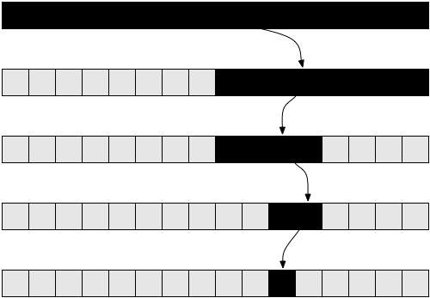
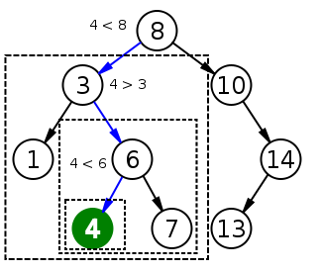
Binary Search
Binary search finds an item within a ordered data structure
At each step, compare the input with the middle element
The algorithm repeats its action to the left or right sub-structure
Visualization

Slide 60
Binary Search Visualization
Steps count: 1
The deck is sorted
Start
Middle
End
9 > 5 ⇨ search in the right half
Look for 9

Slide 61
Binary Search Visualization
Steps count: 2
Start
Middle
End
9 > 7 ⇨ search in the right half

Slide 62
Binary Search Visualization
Steps count: 3
Middle
Start
End
9 > 8 ⇨ search in the right half

Slide 63
Binary Search Visualization
Steps count: 4
Middle
Start
End
9 == 9 ⇨ return the index 7

Slide 64
Binary Search
int binarySearch(int arr[], int key, int start, int end) {
while (end >= start) {
int mid = (start + end) / 2;
if (arr[mid] > key)
end = mid - 1;
else if (arr[mid] < key)
start = mid + 1;
else
return mid;
}
return KEY_NOT_FOUND;
}
Search in the left half of the collection
Search in the right half of the collection

Slide 65
Comparing Searching Algorithms
We need go trough every element
Name | Complexity | n | f(n)
Linear Search | n² | 100 | ≈ 100
Binary Search | n * log(n) | 100 | ≈ 6,64
Binary search can also be implemented iteratively and recursively
On each step we halve the collection

Slide 66

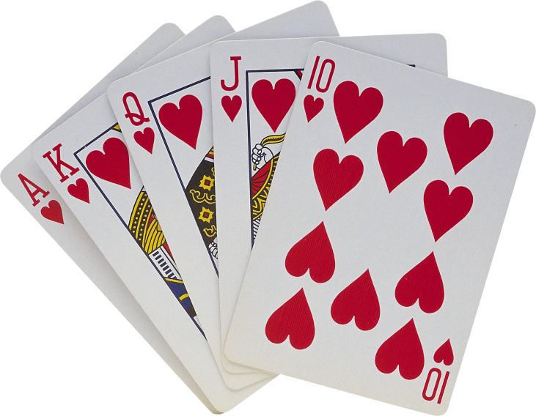
Practice: Sorting and Searching Algorithms
Exercises in class (Lab)

Slide 67
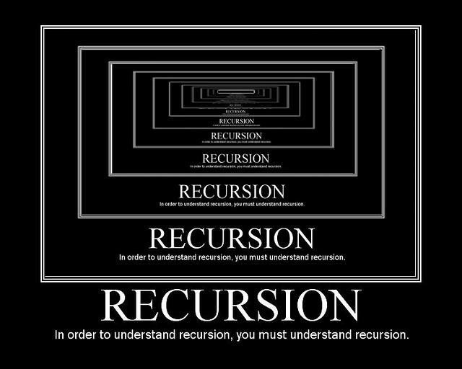
Recursion
Recursive Algorithms

Slide 68
Array Sum – Example
Sum(n - 1)
1
2 | 3 | 4
Sum(n)
Sum((n – 1) - 1)
1 | 2 | 3 | 4
1
2
3 | 4
Sum(((n – 1) - 1) – 1)
1
2
3
4
Base case

Slide 69
What is Recursion?
Problem solving technique
Divides a problem into subproblems of the same type
Involves a function calling itself
The function should have a base case
Each step of the recursion should move towards the base case
Sum(array)
array[0] + Sum(sub-array)
1 | 2 | 3 | 4 | 5
1
2 | 3 | 4 | 5

Slide 70
Array Sum – Example
Sum(n - 1)
1
2 | 3 | 4
Sum(n)
Sum((n – 1) - 1)
1 | 2 | 3 | 4
1
2
3 | 4
Sum(((n – 1) - 1) – 1)
1
2
3
4
Base case

Slide 71
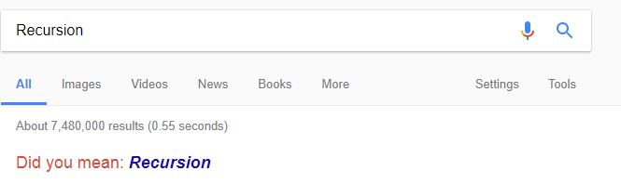
Problem: Array Sum
Create a recursive method that
Reads numbers from the console and stores them in an int[] array
Finds the sum of all numbers
1 2 3 4
10
-1 0 1
0
Check your solution here: https://judge.softuni.bg/Contests/779

Slide 72
Solution: Array Sum
static int sum(int[] array, int index){
if (index == array.length - 1)
{
return array[index];
}
return array[index] + sum(array, index + 1);
}
Base case
Check your solution here: https://judge.softuni.bg/Contests/779

Slide 73
Problem: Recursive Factorial
Create a recursive method that calculates n!
Recursive definition of n!:
n! = n * (n–1)! for n > 0
5! = 5 * 4!
4! = 4 * 3!
3! = 3 * 2!
2! = 2 * 1!
1! = 1 * 0!
5
120
0! = 1
10
3628800
Check your solution here: https://judge.softuni.bg/Contests/779

Slide 74
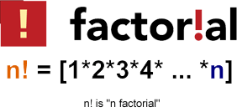
Solution: Recursive Factorial
static long factorial(int num){ if (num == 0)
{
return 1;
}
return num * factorial(num - 1); }
Base case
Check your solution here: https://judge.softuni.bg/Contests/779

Slide 75
Recursion Pre-Actions and Post-Actions
Recursive methods have 3 parts:
Pre-actions (before calling the recursion)
Recursive calls (step-in)
Post-actions (after returning from recursion)
static void Recursion(){ // Pre-actions
Recursion();
// Post-actions }

Slide 76
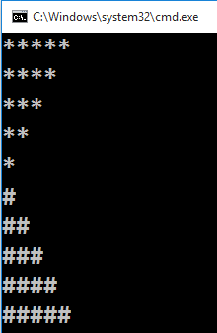
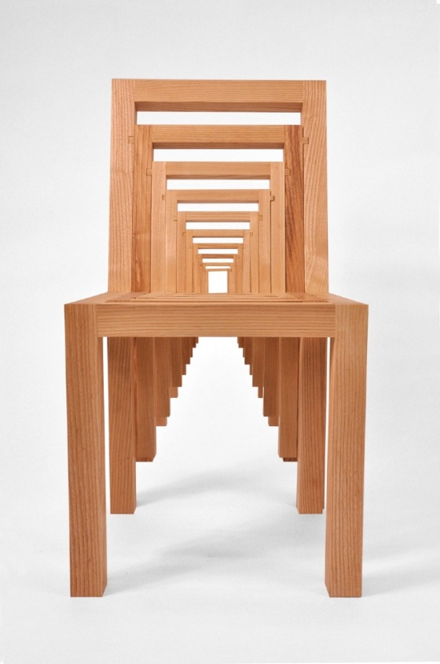
Problem: Recursive Drawing
Create a recursive method that draws the following figure
5
Check your solution here: https://judge.softuni.bg/Contests/779

Slide 77
Solution: Recursive Drawing
static void printFigure(int n)
if (n == 0) // Bottom of the recursion
return;
// Pre-action: print n asterisks
System.out.println(
String.join("", Collections.nCopies(n, "*")));
// Recursive call: print figure of size n-1
printFigure(n - 1);
// Post-action: print n hashtags
System.out.println(
String.join("", Collections.nCopies(n, "#")));
Returns a String consisting of n copies of ‘*’.
Check your solution here: https://judge.softuni.bg/Contests/779

Slide 78
Performance: Recursion vs. Iteration
Recursive calls are slightly slower than iteration
Parameters and return values travel through the stack at each step
Prefer iteration for linear calculations (without branched calls)
Recursive factorial:
Iterative factorial:
static long fact(int n){ if (n == 0)
return 1; else
return n * fact(n - 1); }
static long iterFact(int num){ long result = 1;
for (int i = 1; i <= n; i++)
result *= i;
return result; }

Slide 79
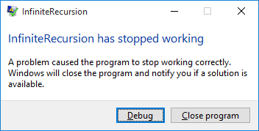
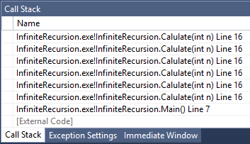

Infinite Recursion
Infinite recursion == a method calls itself infinitely
Typically, infinite recursion is a bug in the program
The bottom of the recursion is missing or wrong
Causes "stack overflow" exception
static long Calulate(int n){
return Calulate(n + 1);
}

Slide 80


Practice: Recursion
Exercises in class (Lab)

Slide 81

Summary
Sorting == an algorithm that rearranges elements in a list
In non-decreasing order
Searching == an algorithm for finding an item among a collection of items
Recursion means to call a method from itself
It should always have a bottom
Each step should move towards the bottom

